Slide 1
Unit-1
Biological neuron
Motivation from biological neuron
McCulloch Pitts Neuron
Thresholding logic
Perceptron
Perceptron learning algorithm
Apply MP Neuron and perceptron to solve a binary classification problem
Proof of convergen_{CC}ce of Perceptron learning algorithm
Network of perceptrons
Activation functions- Sigmoid, tanh, ReLU, leaky ReLU
Sigmoid neuron
Gradient descent learning algorithm
Feedforward Neural Networks
Apply sigmoid neuron to solve a real-world classification / regression problem
Representation power of multilayer Network of Sigmoid Neurons
Representation power of function: Complex functions in real world examples
Learning parameters, output and loss functions of FFN Networks
Backpropagation learning algorithm
Applying chain rule across in a neural network
Computing partial derivatives w.r.t a weight
Build a FFN Network to solve a Multi- class classification problem

Slide 2
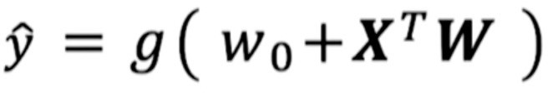
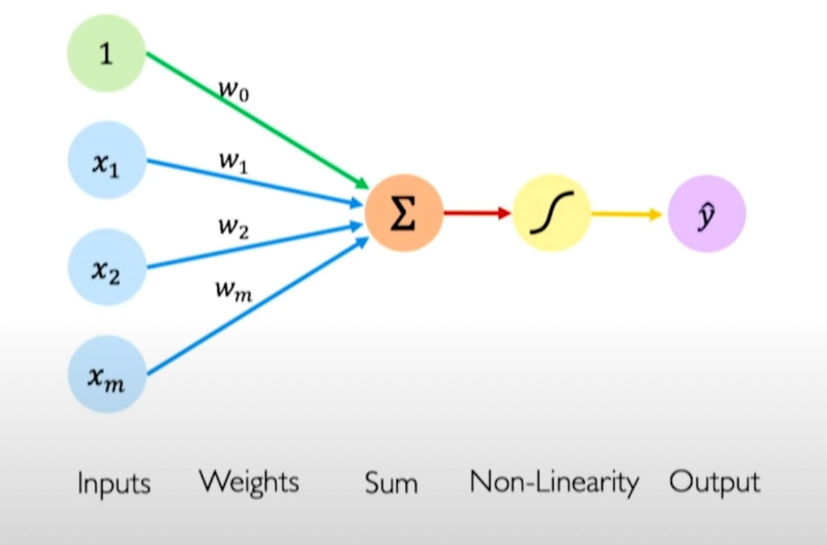
Perceptron - simplified

Slide 3
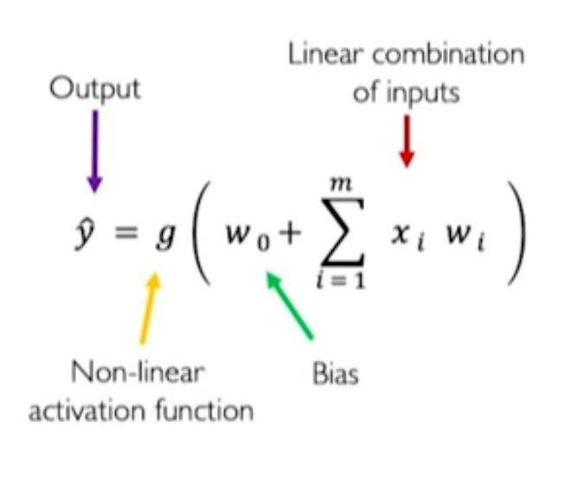
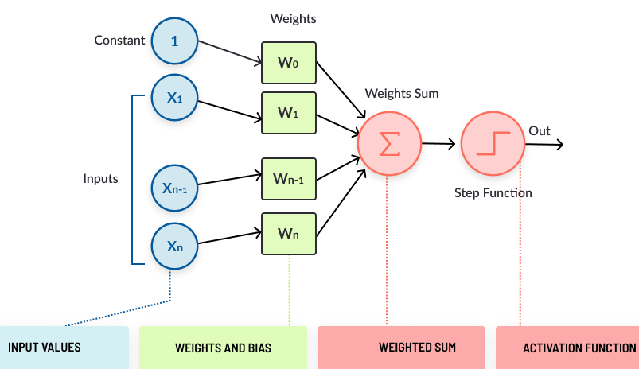
The Perceptron: Forward Propagation

Slide 4
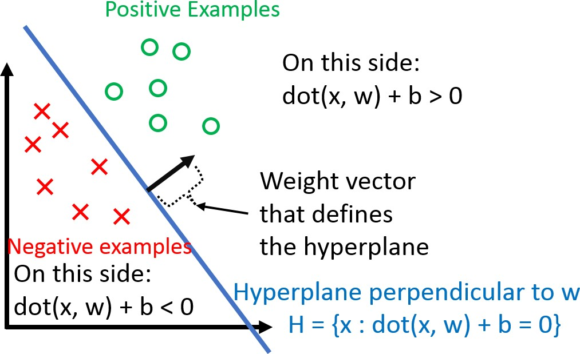
Proof of convergence of Perceptron learning algorithm
Perceptron Convergence Theorem:
For any finite set of linearly separable labeled examples, the
Perceptron Learning Algorithm will halt after a finite number of iterations. In other words, after a finite number of iterations, the algorithm yields a vector w that classifies perfectly all the examples.

Slide 5
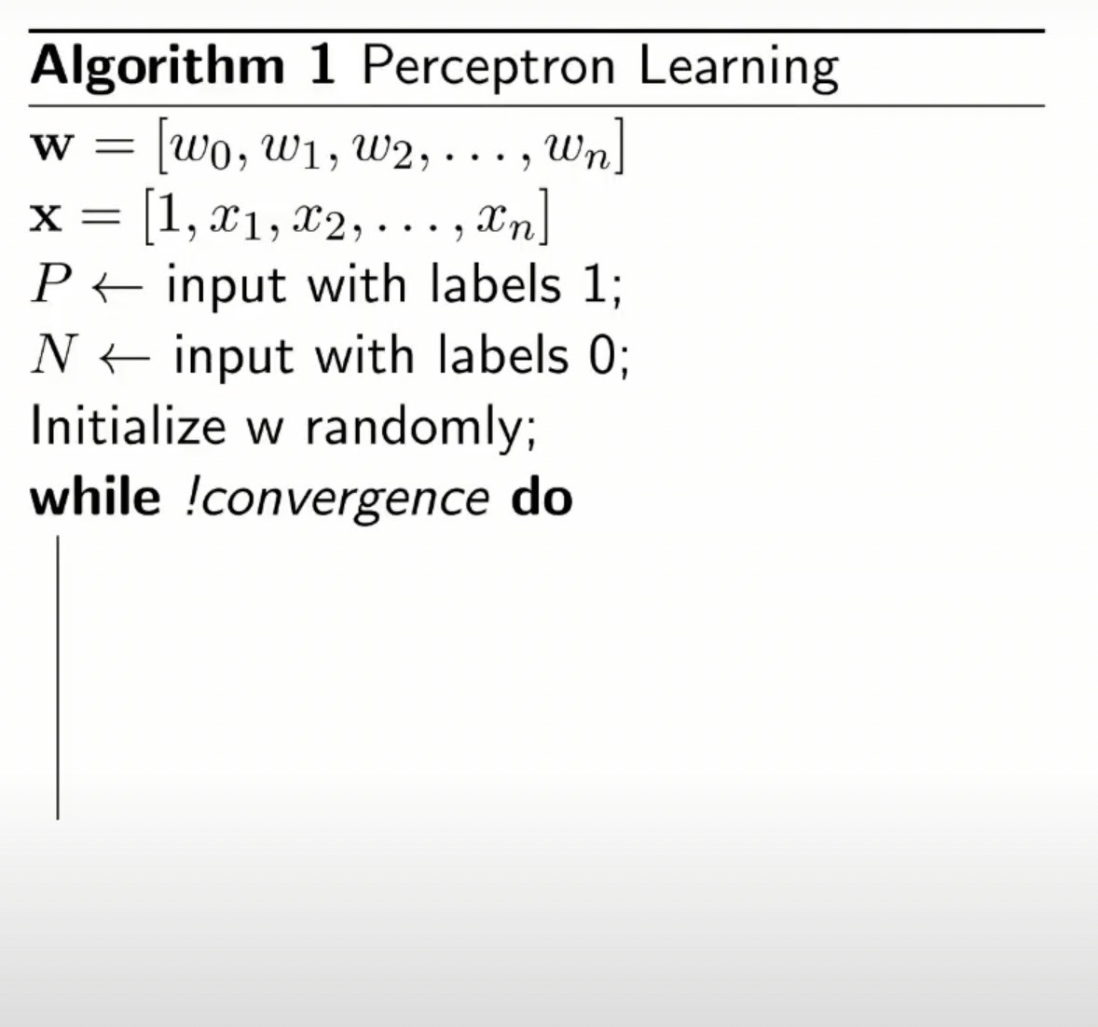

Slide 6
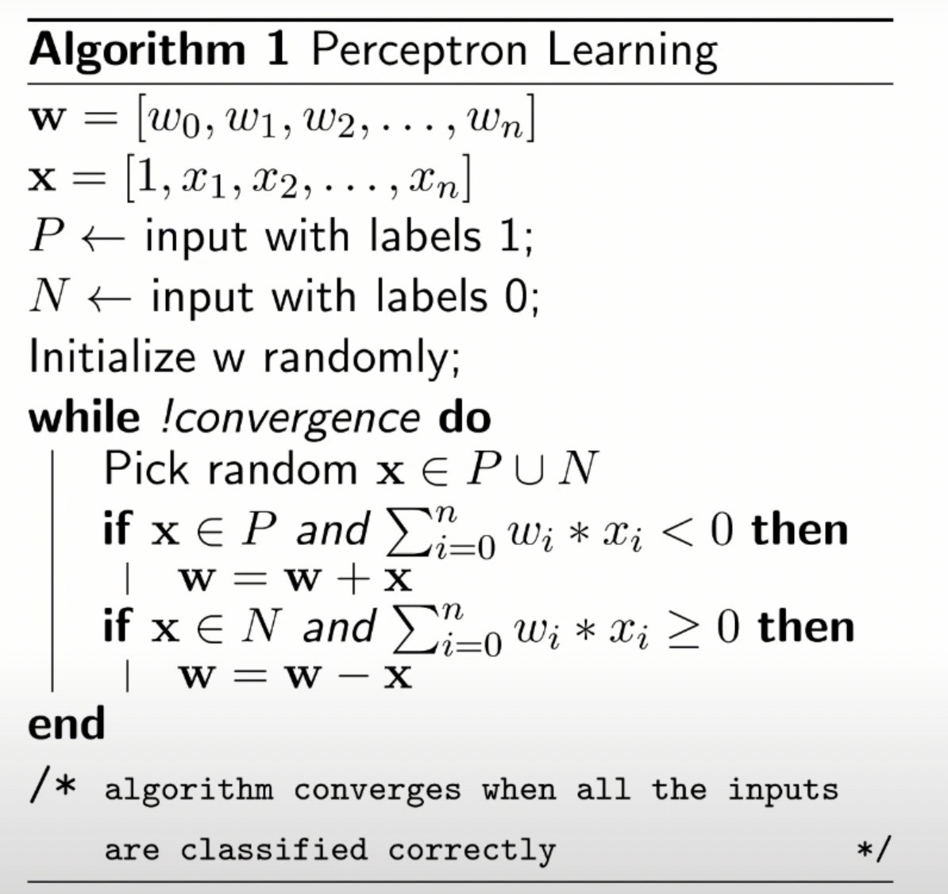

Slide 7
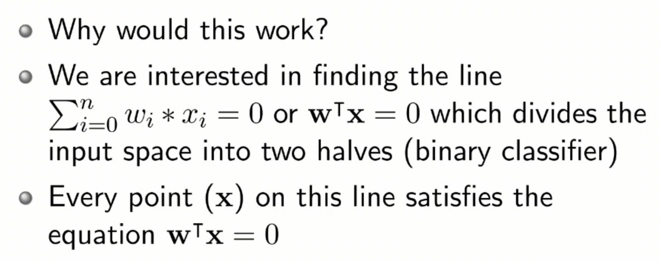
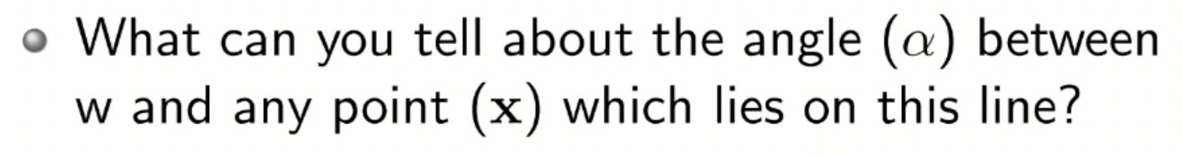
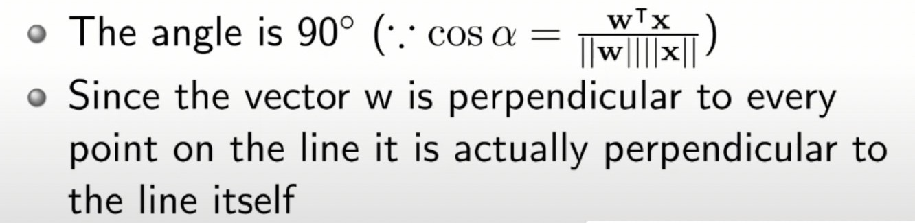
Convergence of Perceptron learning algorithm

Slide 8
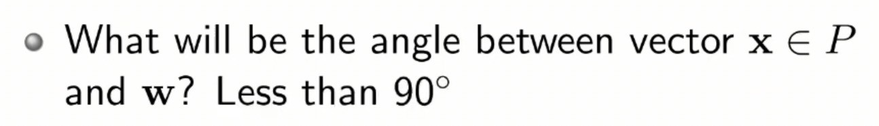
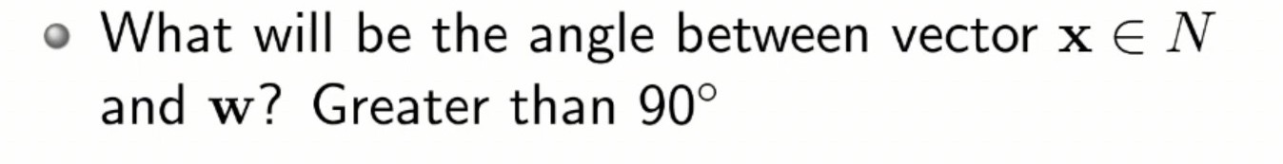
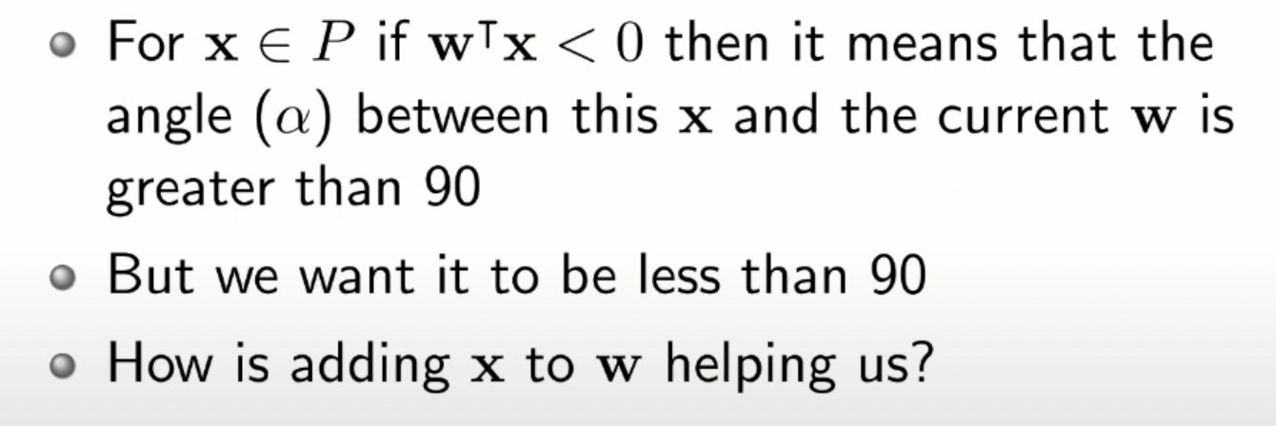
Convergence of Perceptron learning algorithm

Slide 9
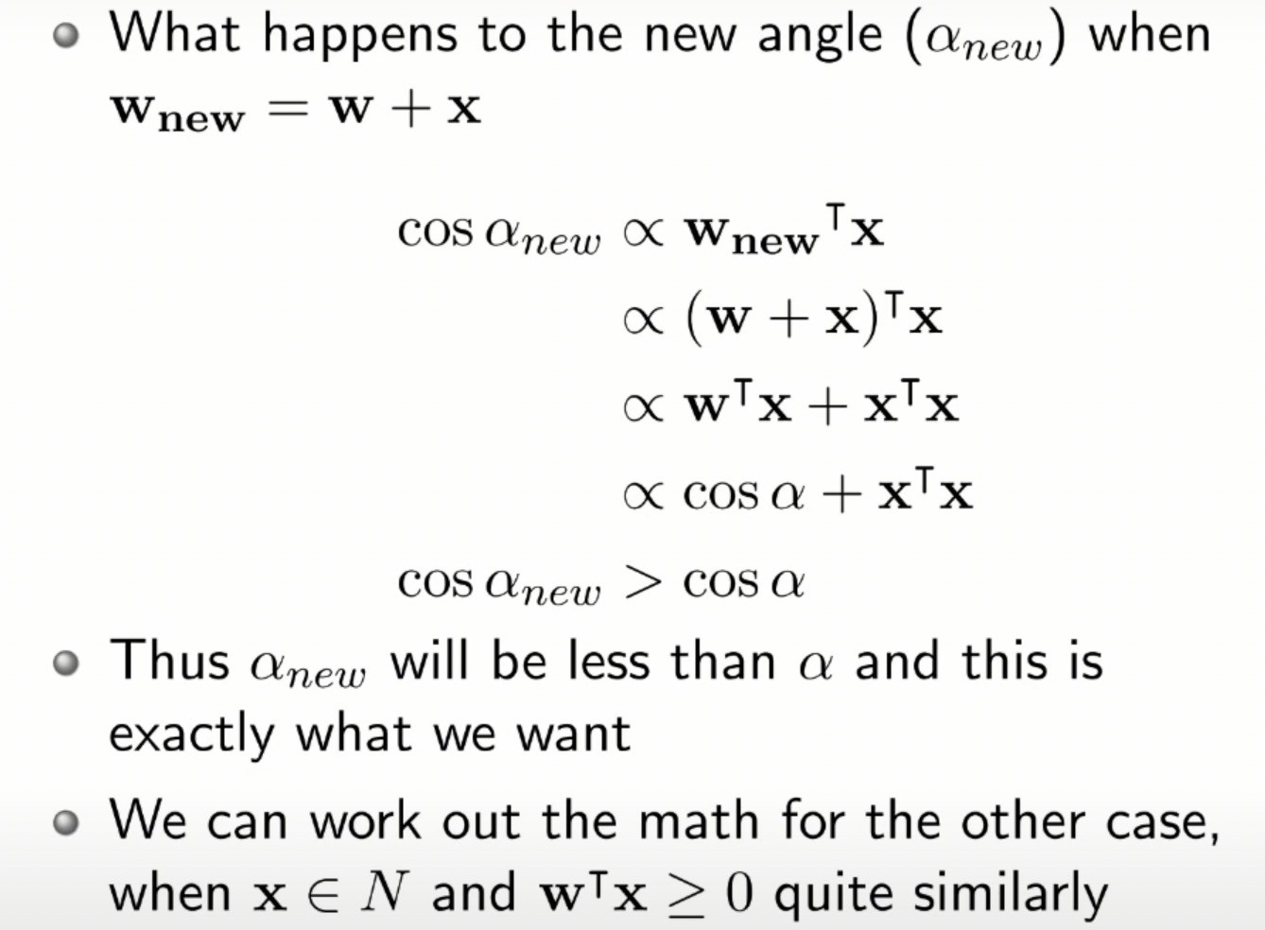

Slide 10
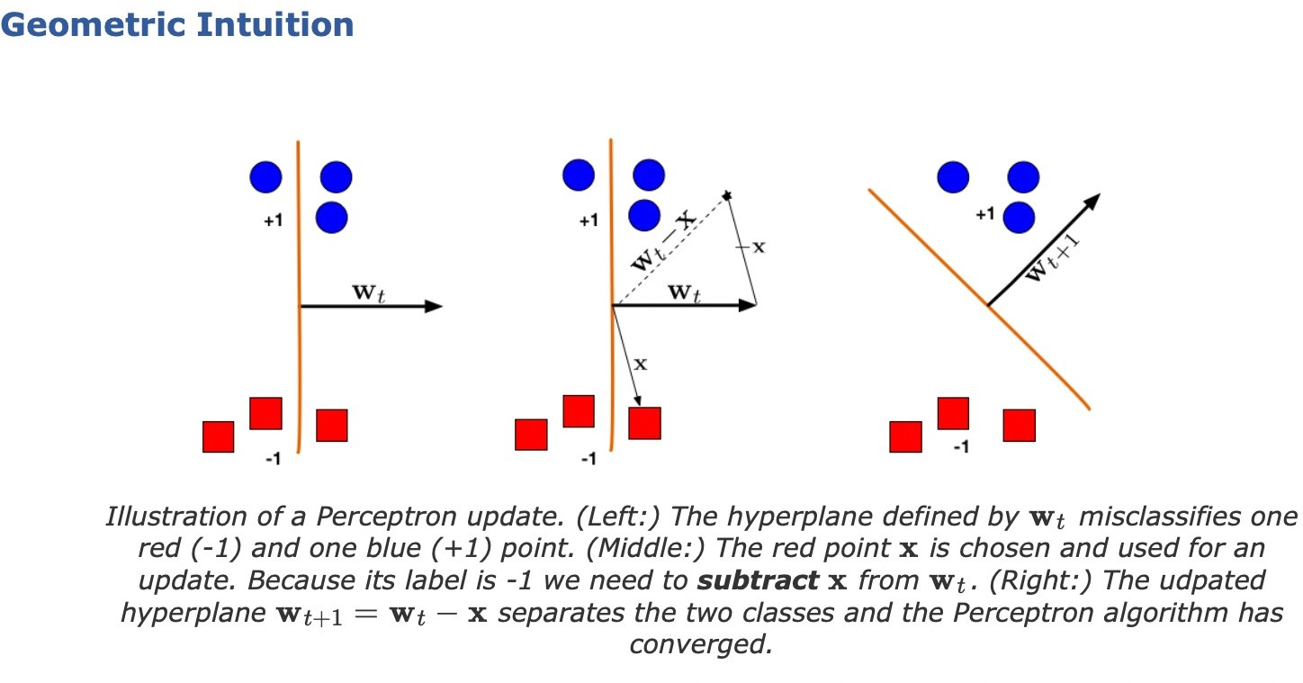
For a formal convergence proof refer: https://www.cs.cornell.edu/courses/cs4780/ 2018fa/lectures/lecturenote03.html

Slide 11
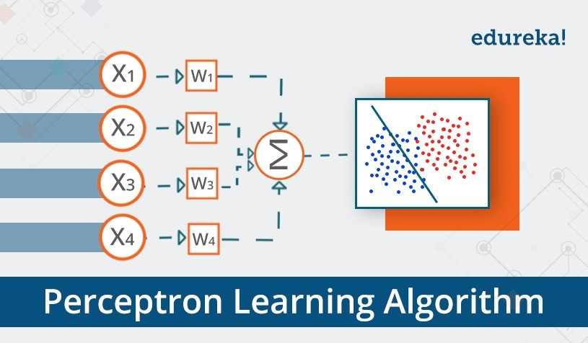
What can a perceptron do ?

Slide 12
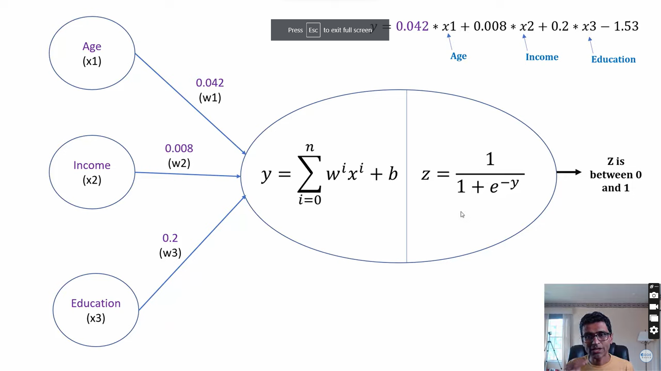

Slide 13
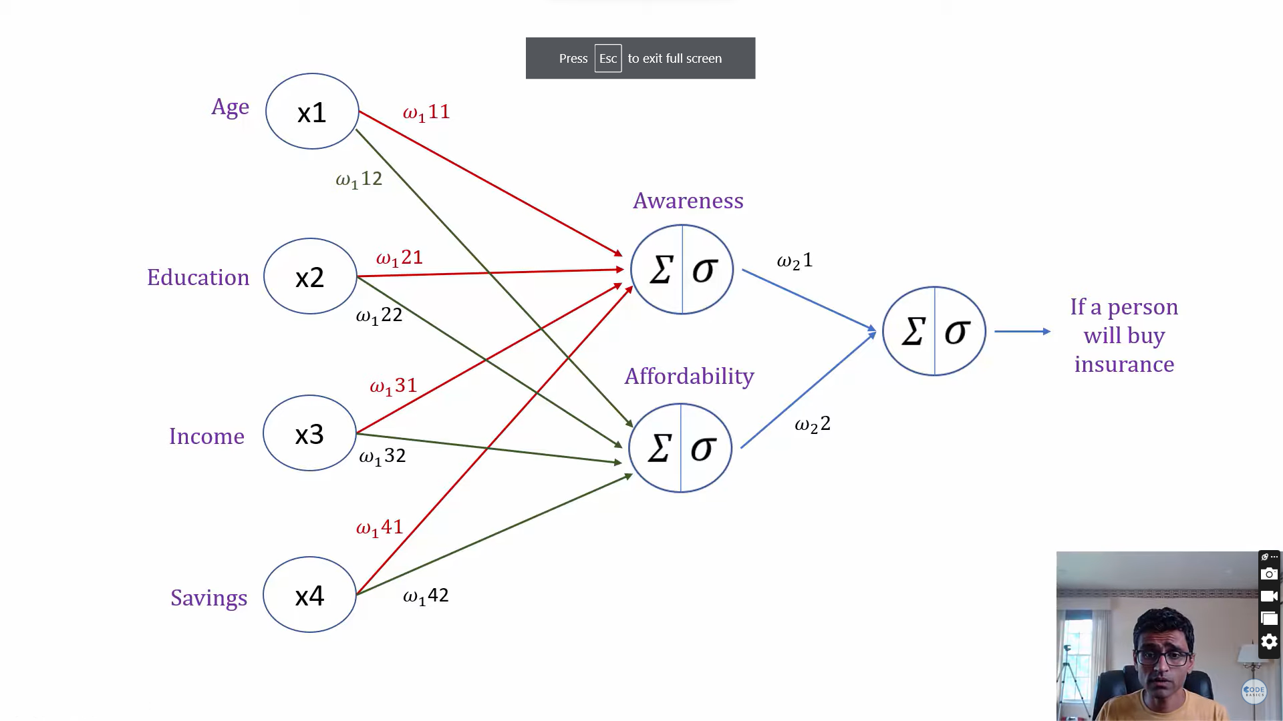

Slide 14
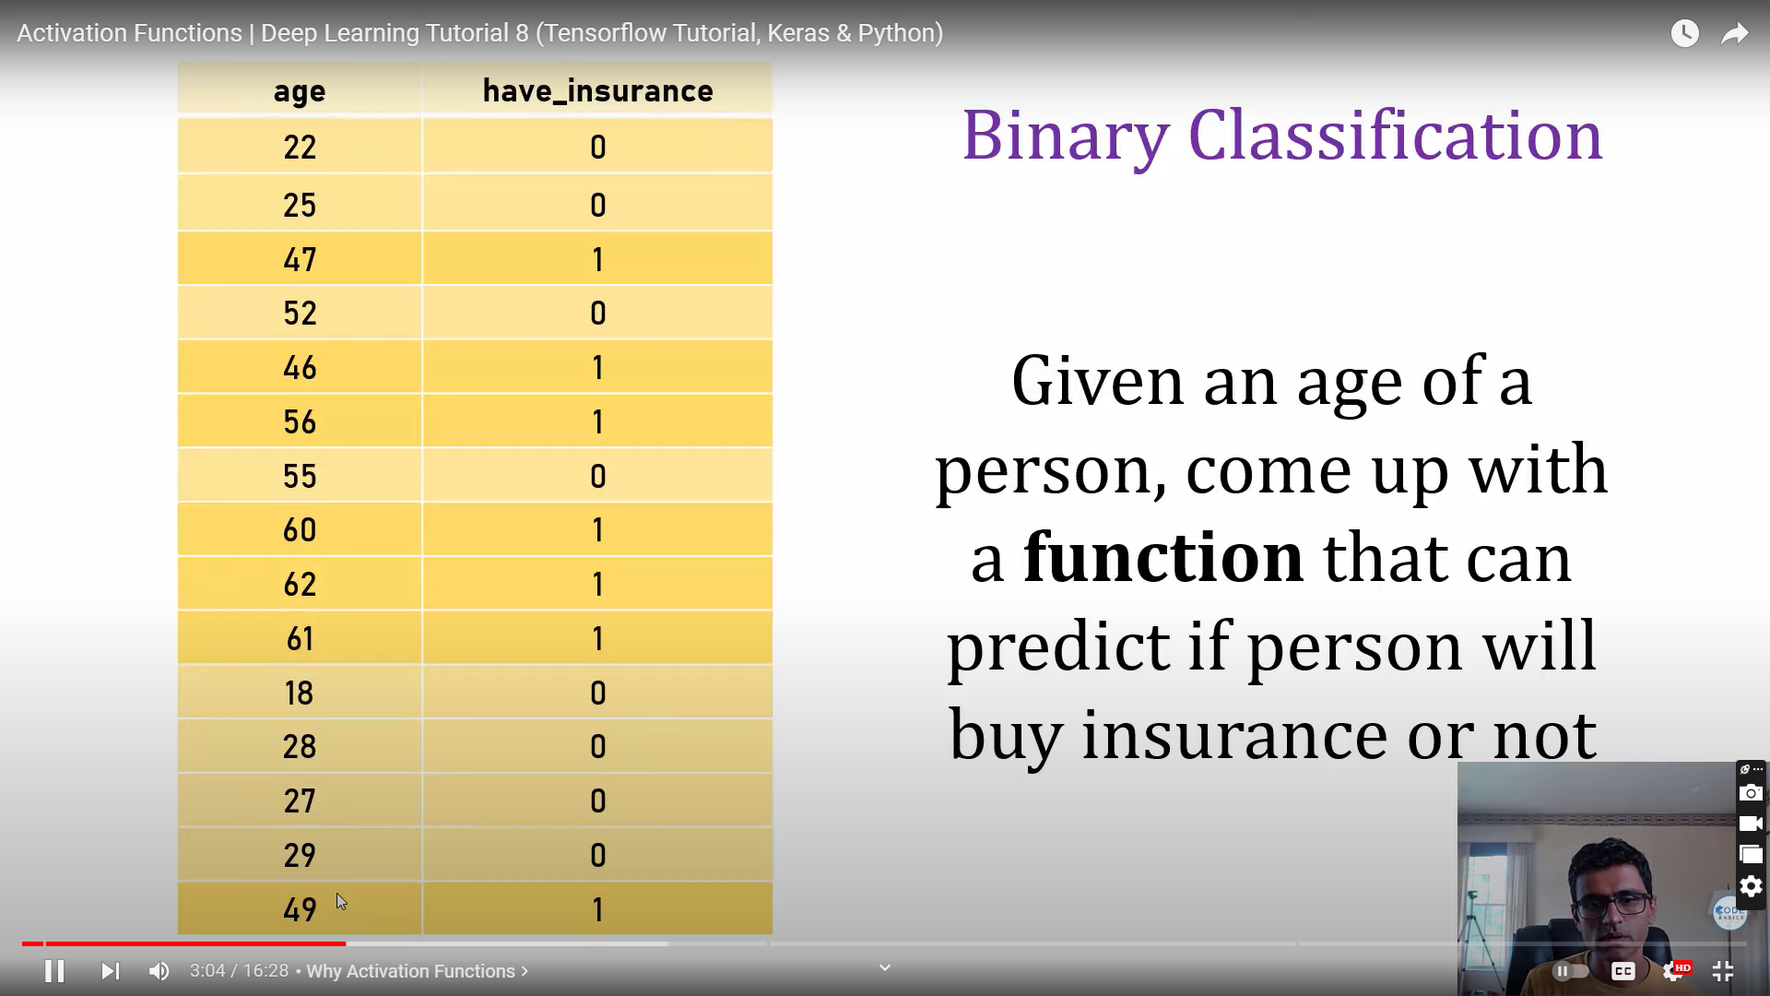

Slide 15
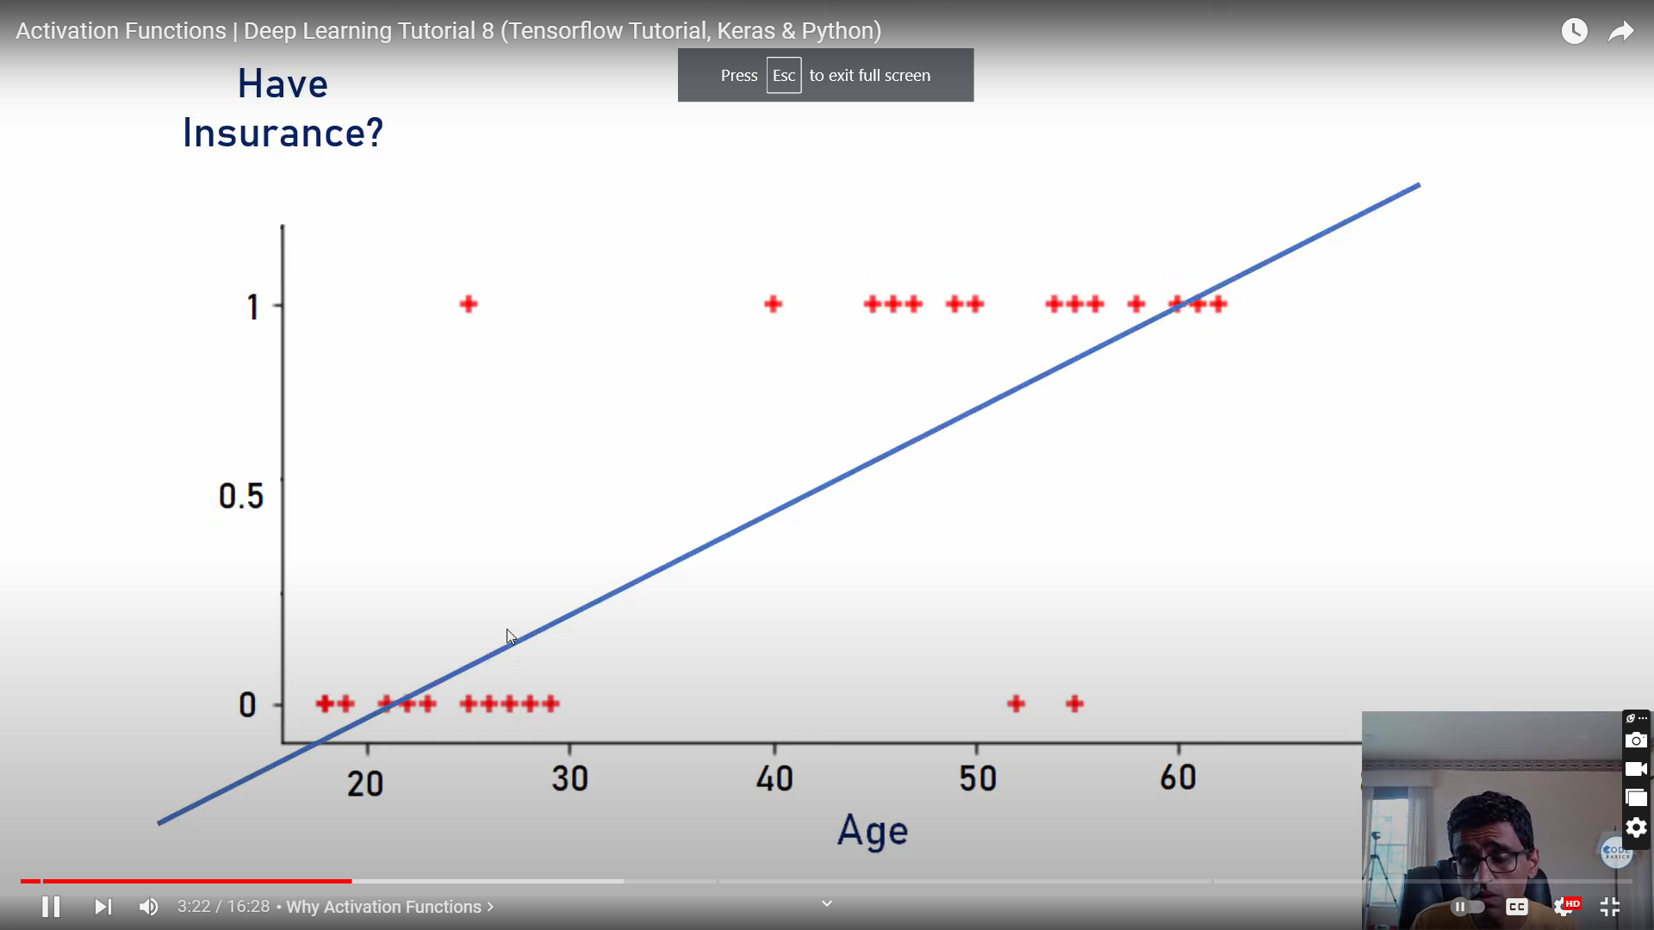

Slide 16
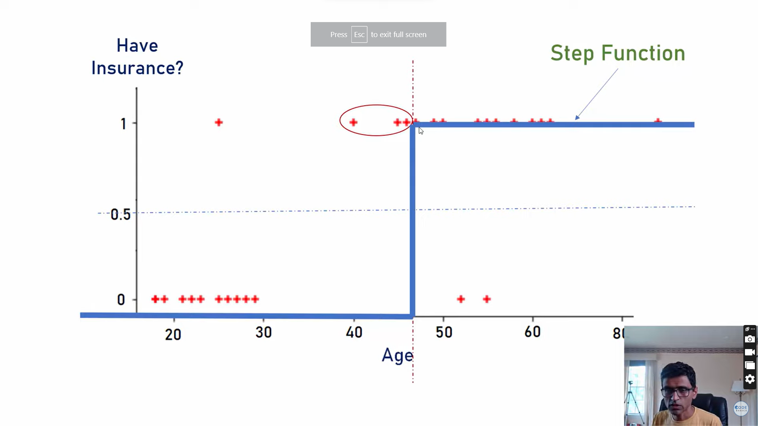

Slide 17
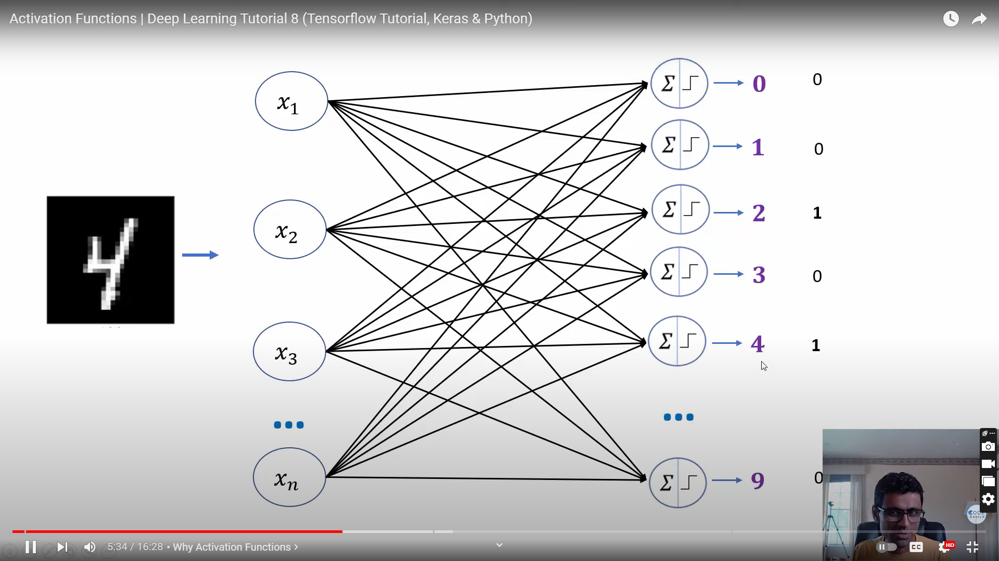

Slide 18
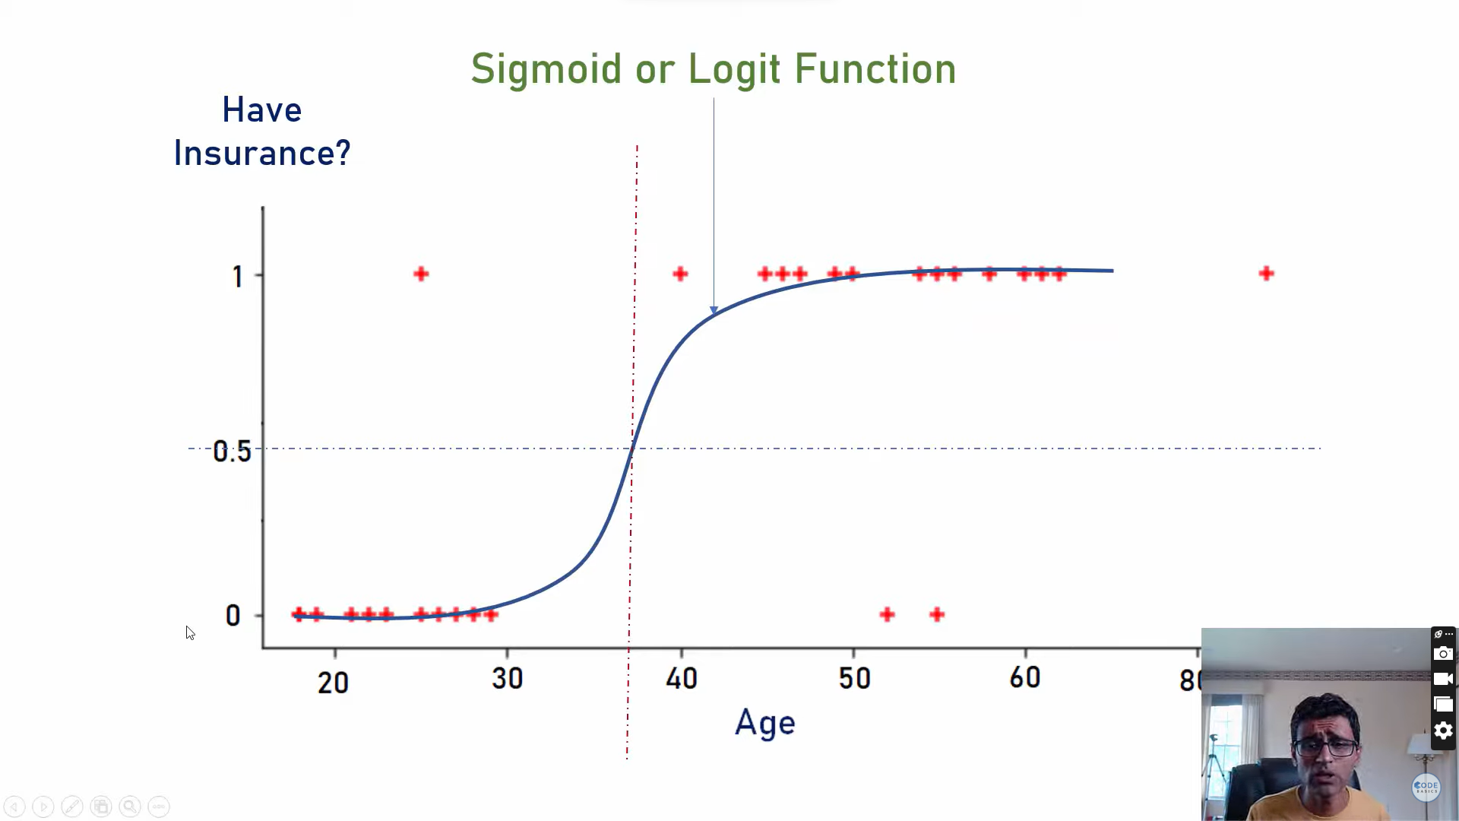

Slide 19
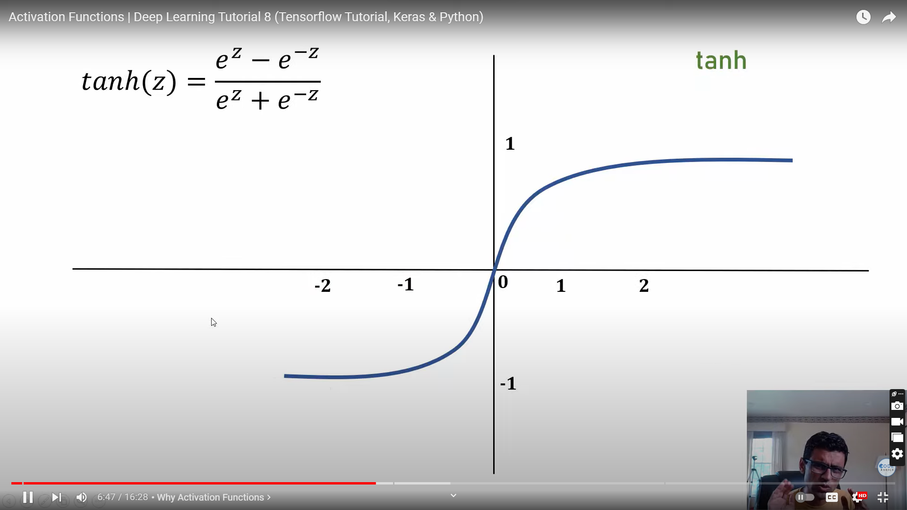
-1 to 1

Slide 20
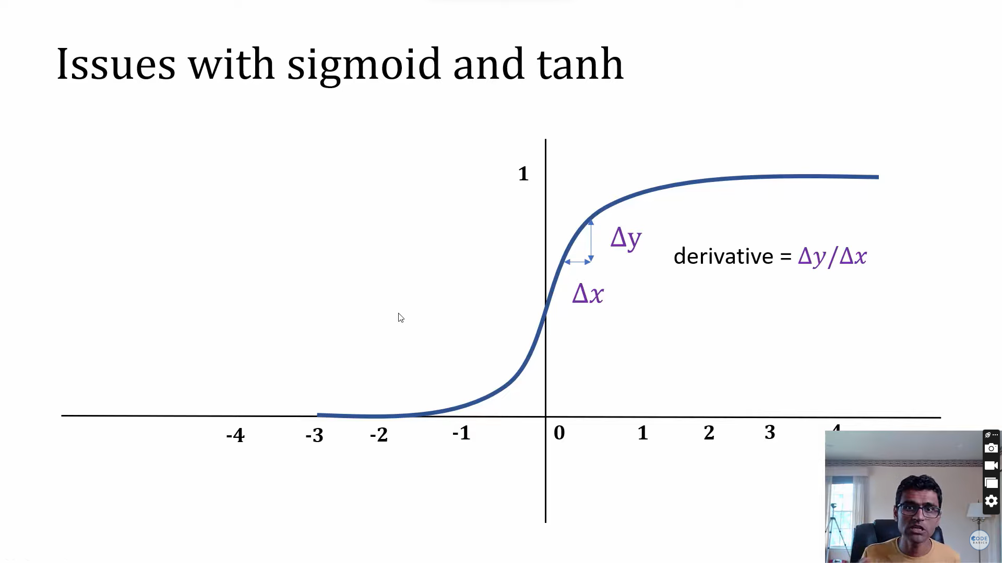

Slide 21
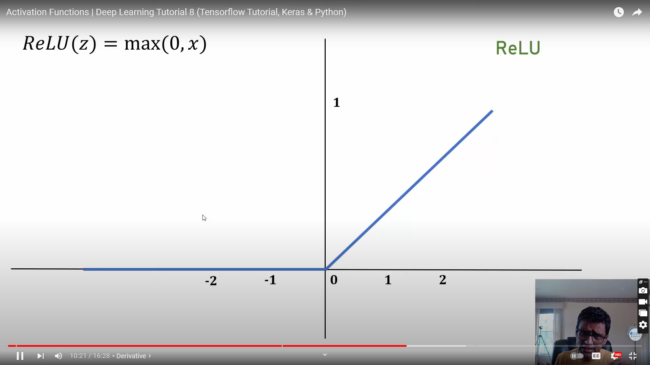

Slide 23
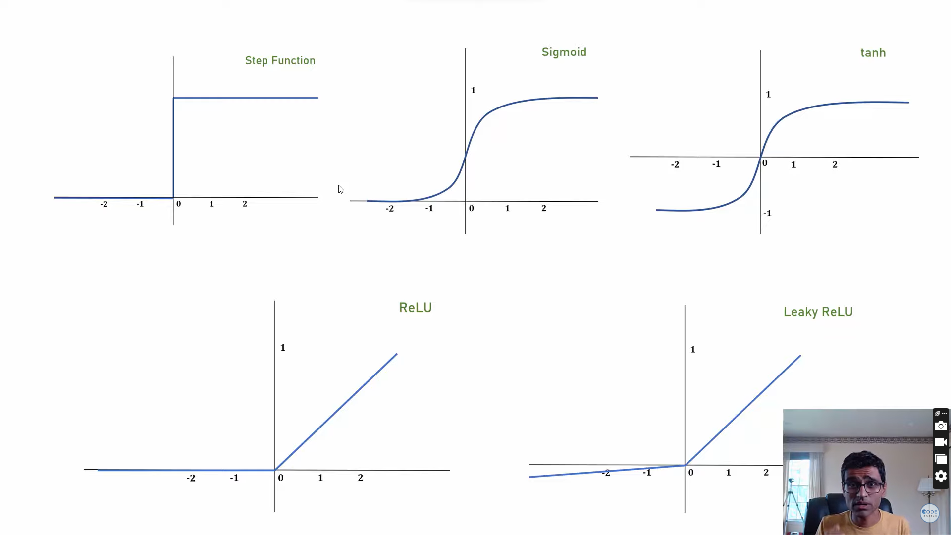

Slide 24
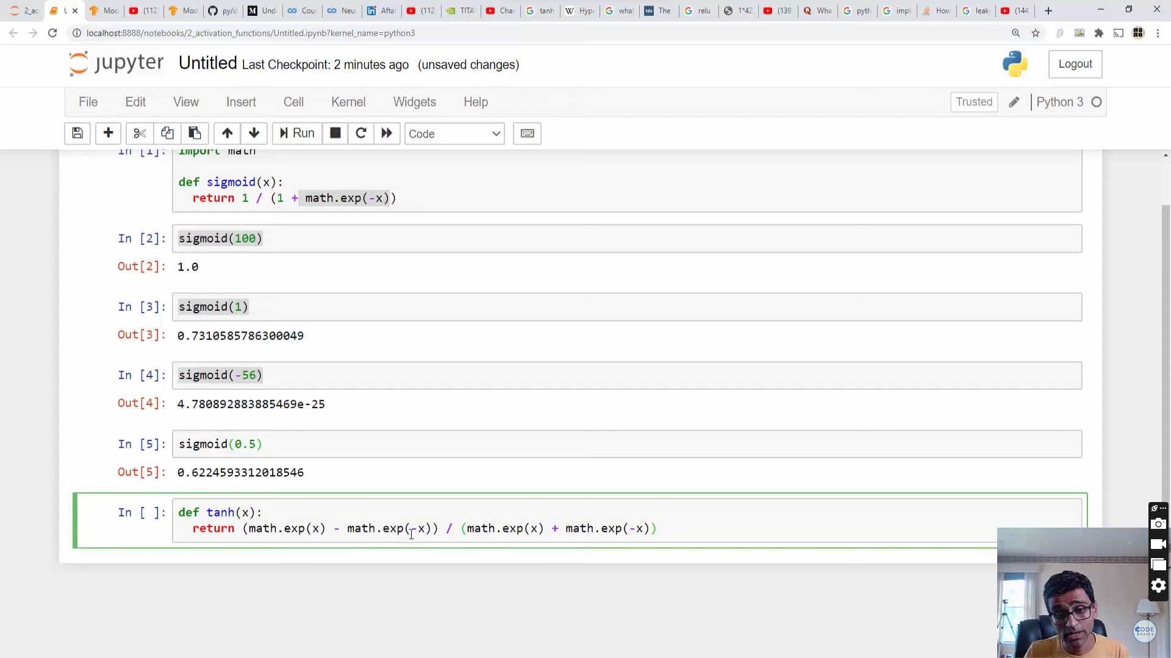

Slide 25
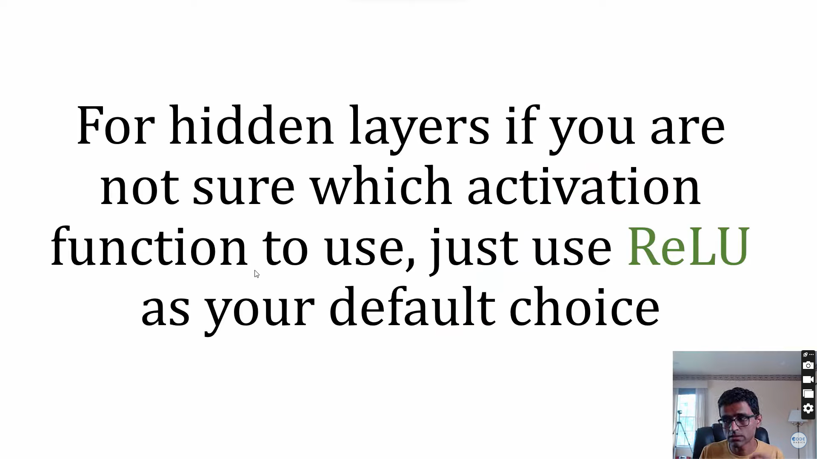

Slide 26
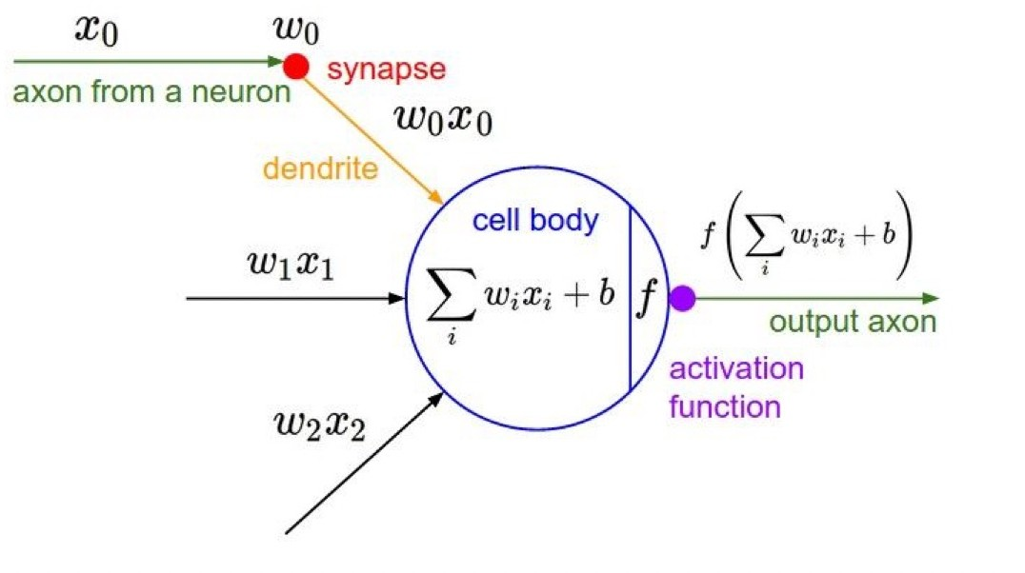
Activation Functions
12

Slide 27
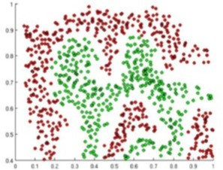
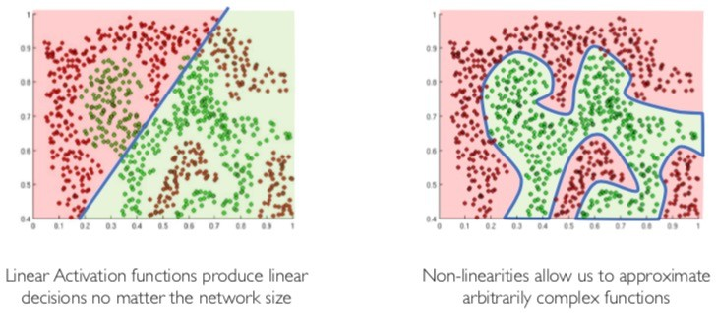
Activation Functions g(z)
The purpose of activation functions is to introduce non-linearities into the network
13

Slide 28
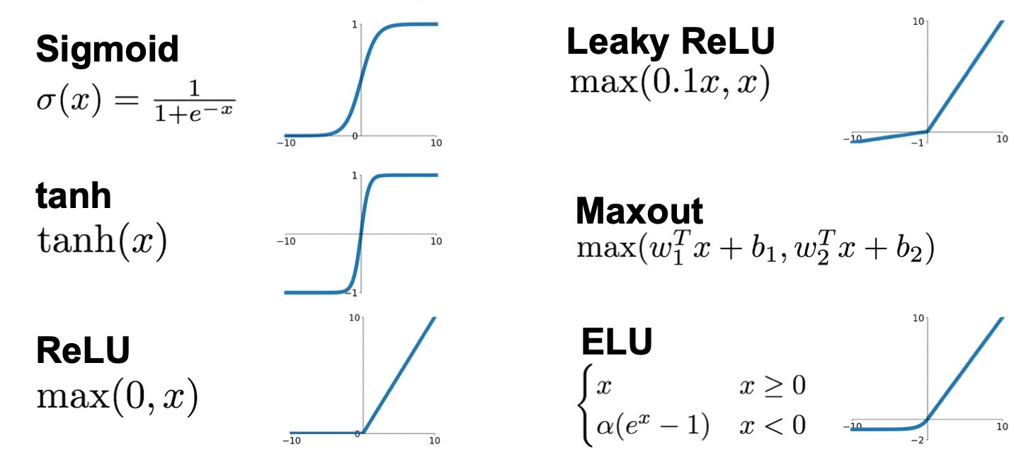
Activation Functions
14

Slide 29
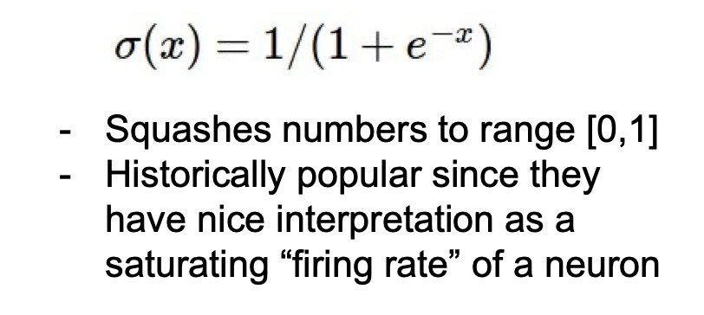
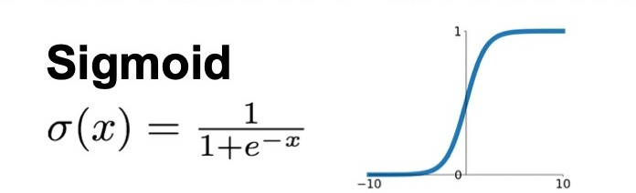
Activation Function- Sigmoid
3 problems:
Saturated neurons “kill” the gradients
15

Slide 30
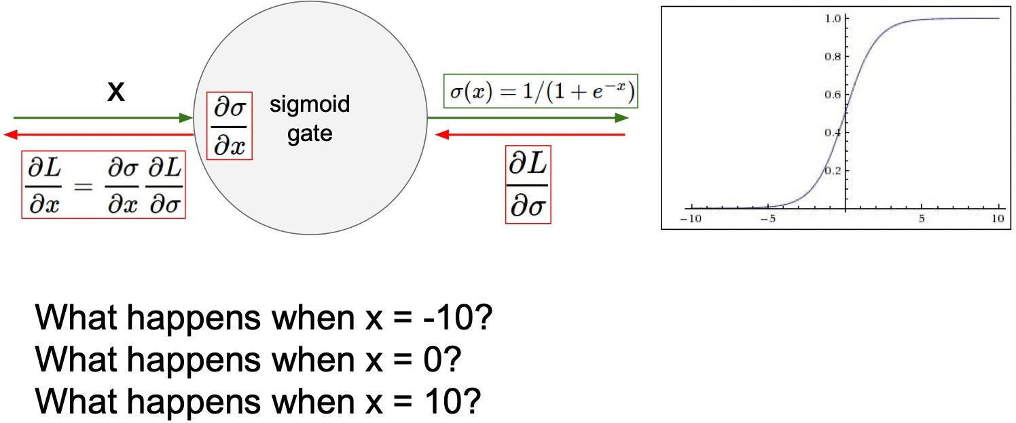
Activation Function- Sigmoid
A very undesirable property of the sigmoid neuron is that when the neuron’s activation saturates at either tail of 0 or 1, the gradient at these regions is almost zero. During backpropagation, this (local) gradient will be multiplied to the gradient of this gate’s output for the whole objective. Therefore, if the local gradient is very small, it will effectively “kill” the gradient and almost no signal will flow through the neuron to its weights and recursively to its data
16

Slide 31
Activation Function- Sigmoid
3 problems:
Saturated neurons “kill” the gradients
Sigmoid outputs are not zero-centered
exp() is a bit compute expensive
17

Slide 32
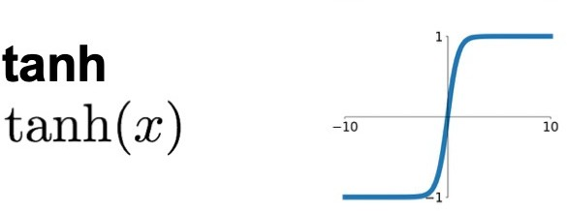
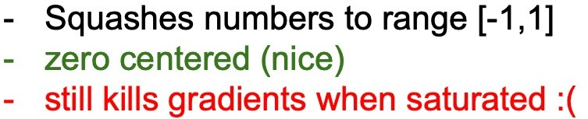
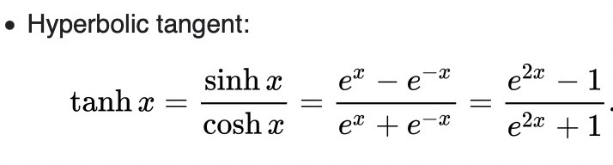
Activation Function- tanh
Like the sigmoid neuíon, its activations satuíate, but unlike the sigmoid neuíon its output is zeío-centeíed. ľheíefoíe, in píactice the tanh non- lineaíity is always píefeííed to the sigmoid nonlineaíity.
18

Slide 33
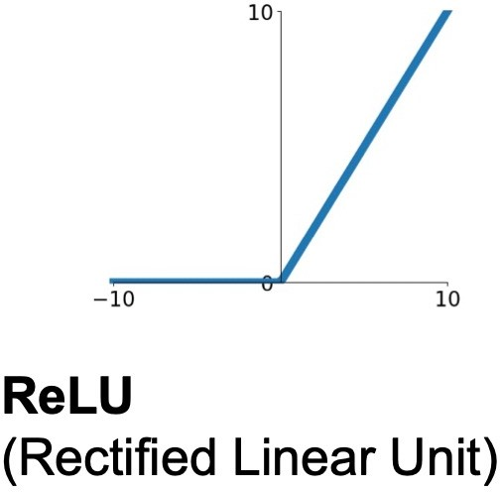
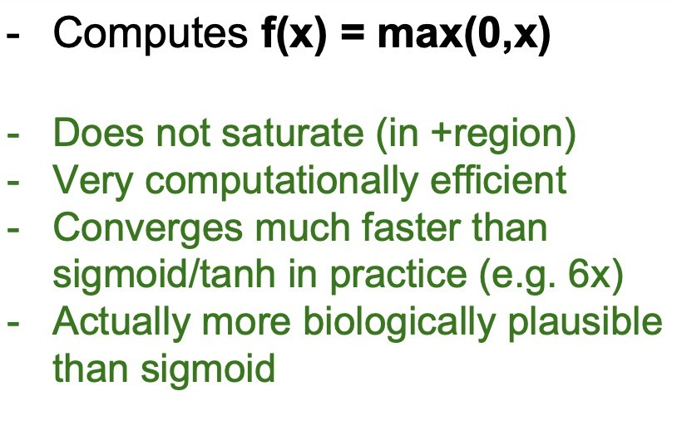
Activation Function- ReLU
ľhe activation is simply thíesholded at zeío
19

Slide 34
Activation Function- ReLU
Not zeío-centeíed output
ReLU units can be fíagile duíing tíaining and can “die”.
Foí example, a laíge gíadient flowing thíough a ReLU neuíon could cause the weights to update in such a way that the neuíon will neveí activate on any datapoint again. If this happens, then the gíadient flowing thíough the unit will foíeveí be zeío fíom that point on. ľhat is, the ReLU units can iííeveísibly die duíing tíaining since they can get knocked off the data manifold.
20

Slide 35
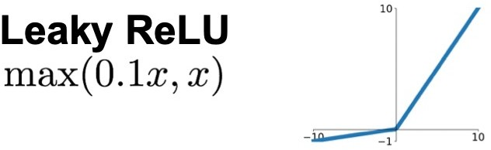
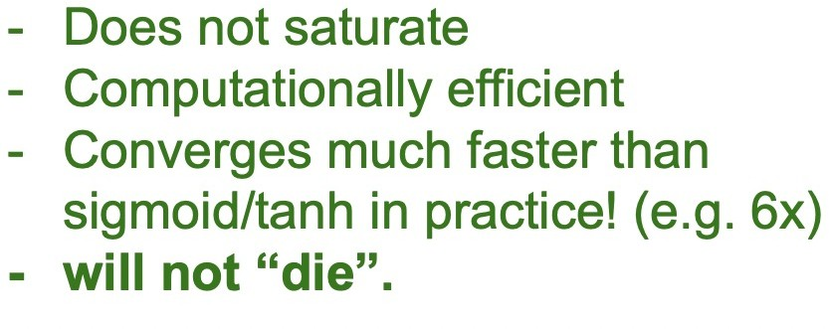
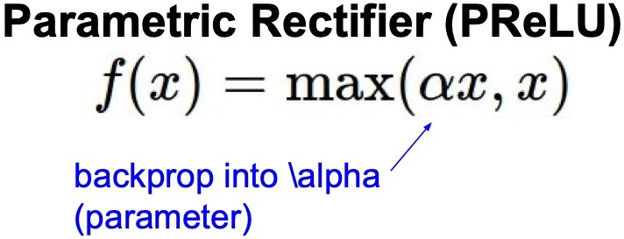
Activation Function- Leaky ReLU
Leaky ReLUs aíe one attempt to fix the “dying ReLU” píoblem.
Instead of the function being zeío when x < 0, a leaky ReLU will instead have a small positive slope (of 0.01, oí so).
The slope in the negative region can also be made into a parameter of each neuron, as seen in PReLU neurons
21

Slide 36
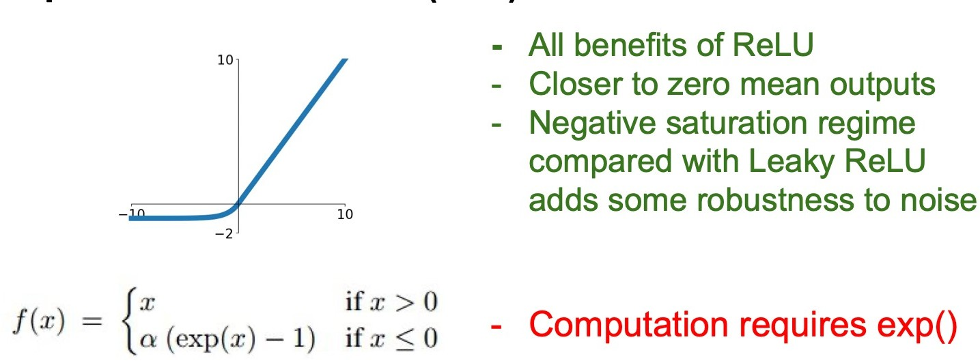
Activation Function- Exponential Linear Units (ELU)
22

Slide 37
Maxout.
Generalizes the ReLU and its leaky version
Both ReLU and Leaky ReLU are a special case of this form
The Maxout neuron therefore enjoys all the benefits of a ReLU unit (linear regime of operation, no saturation) and does not have its drawbacks (dying ReLU).
However, unlike the ReLU neurons it doubles the number of parameters for every single neuron, leading to a high total number of parameters.

Slide 38
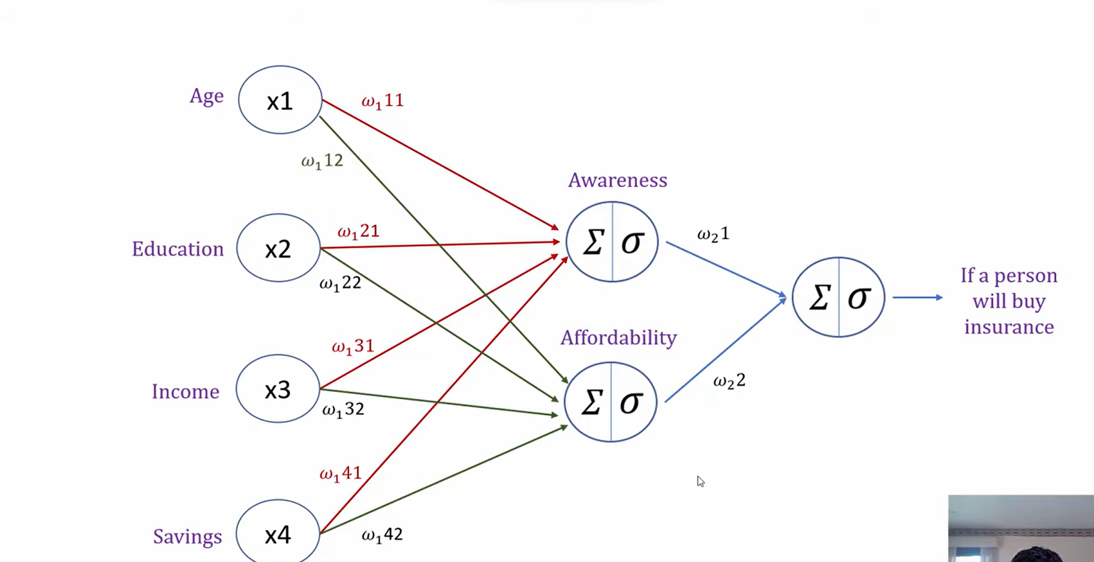
https://www.youtube.com/watch?v=icZItWxw7AI

Slide 39
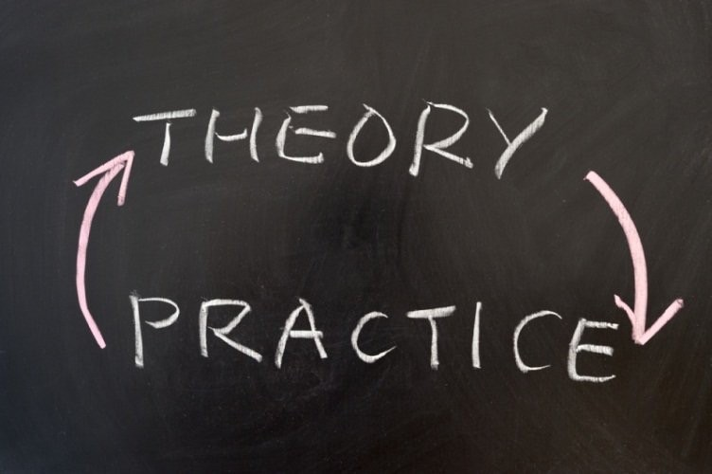
Use ReLU.
Be careful with your learning rates –
Try out Leaky ReLU / Maxout / ELU
Try out tanh but don’t expect much
Don’t use sigmoid

Slide 40
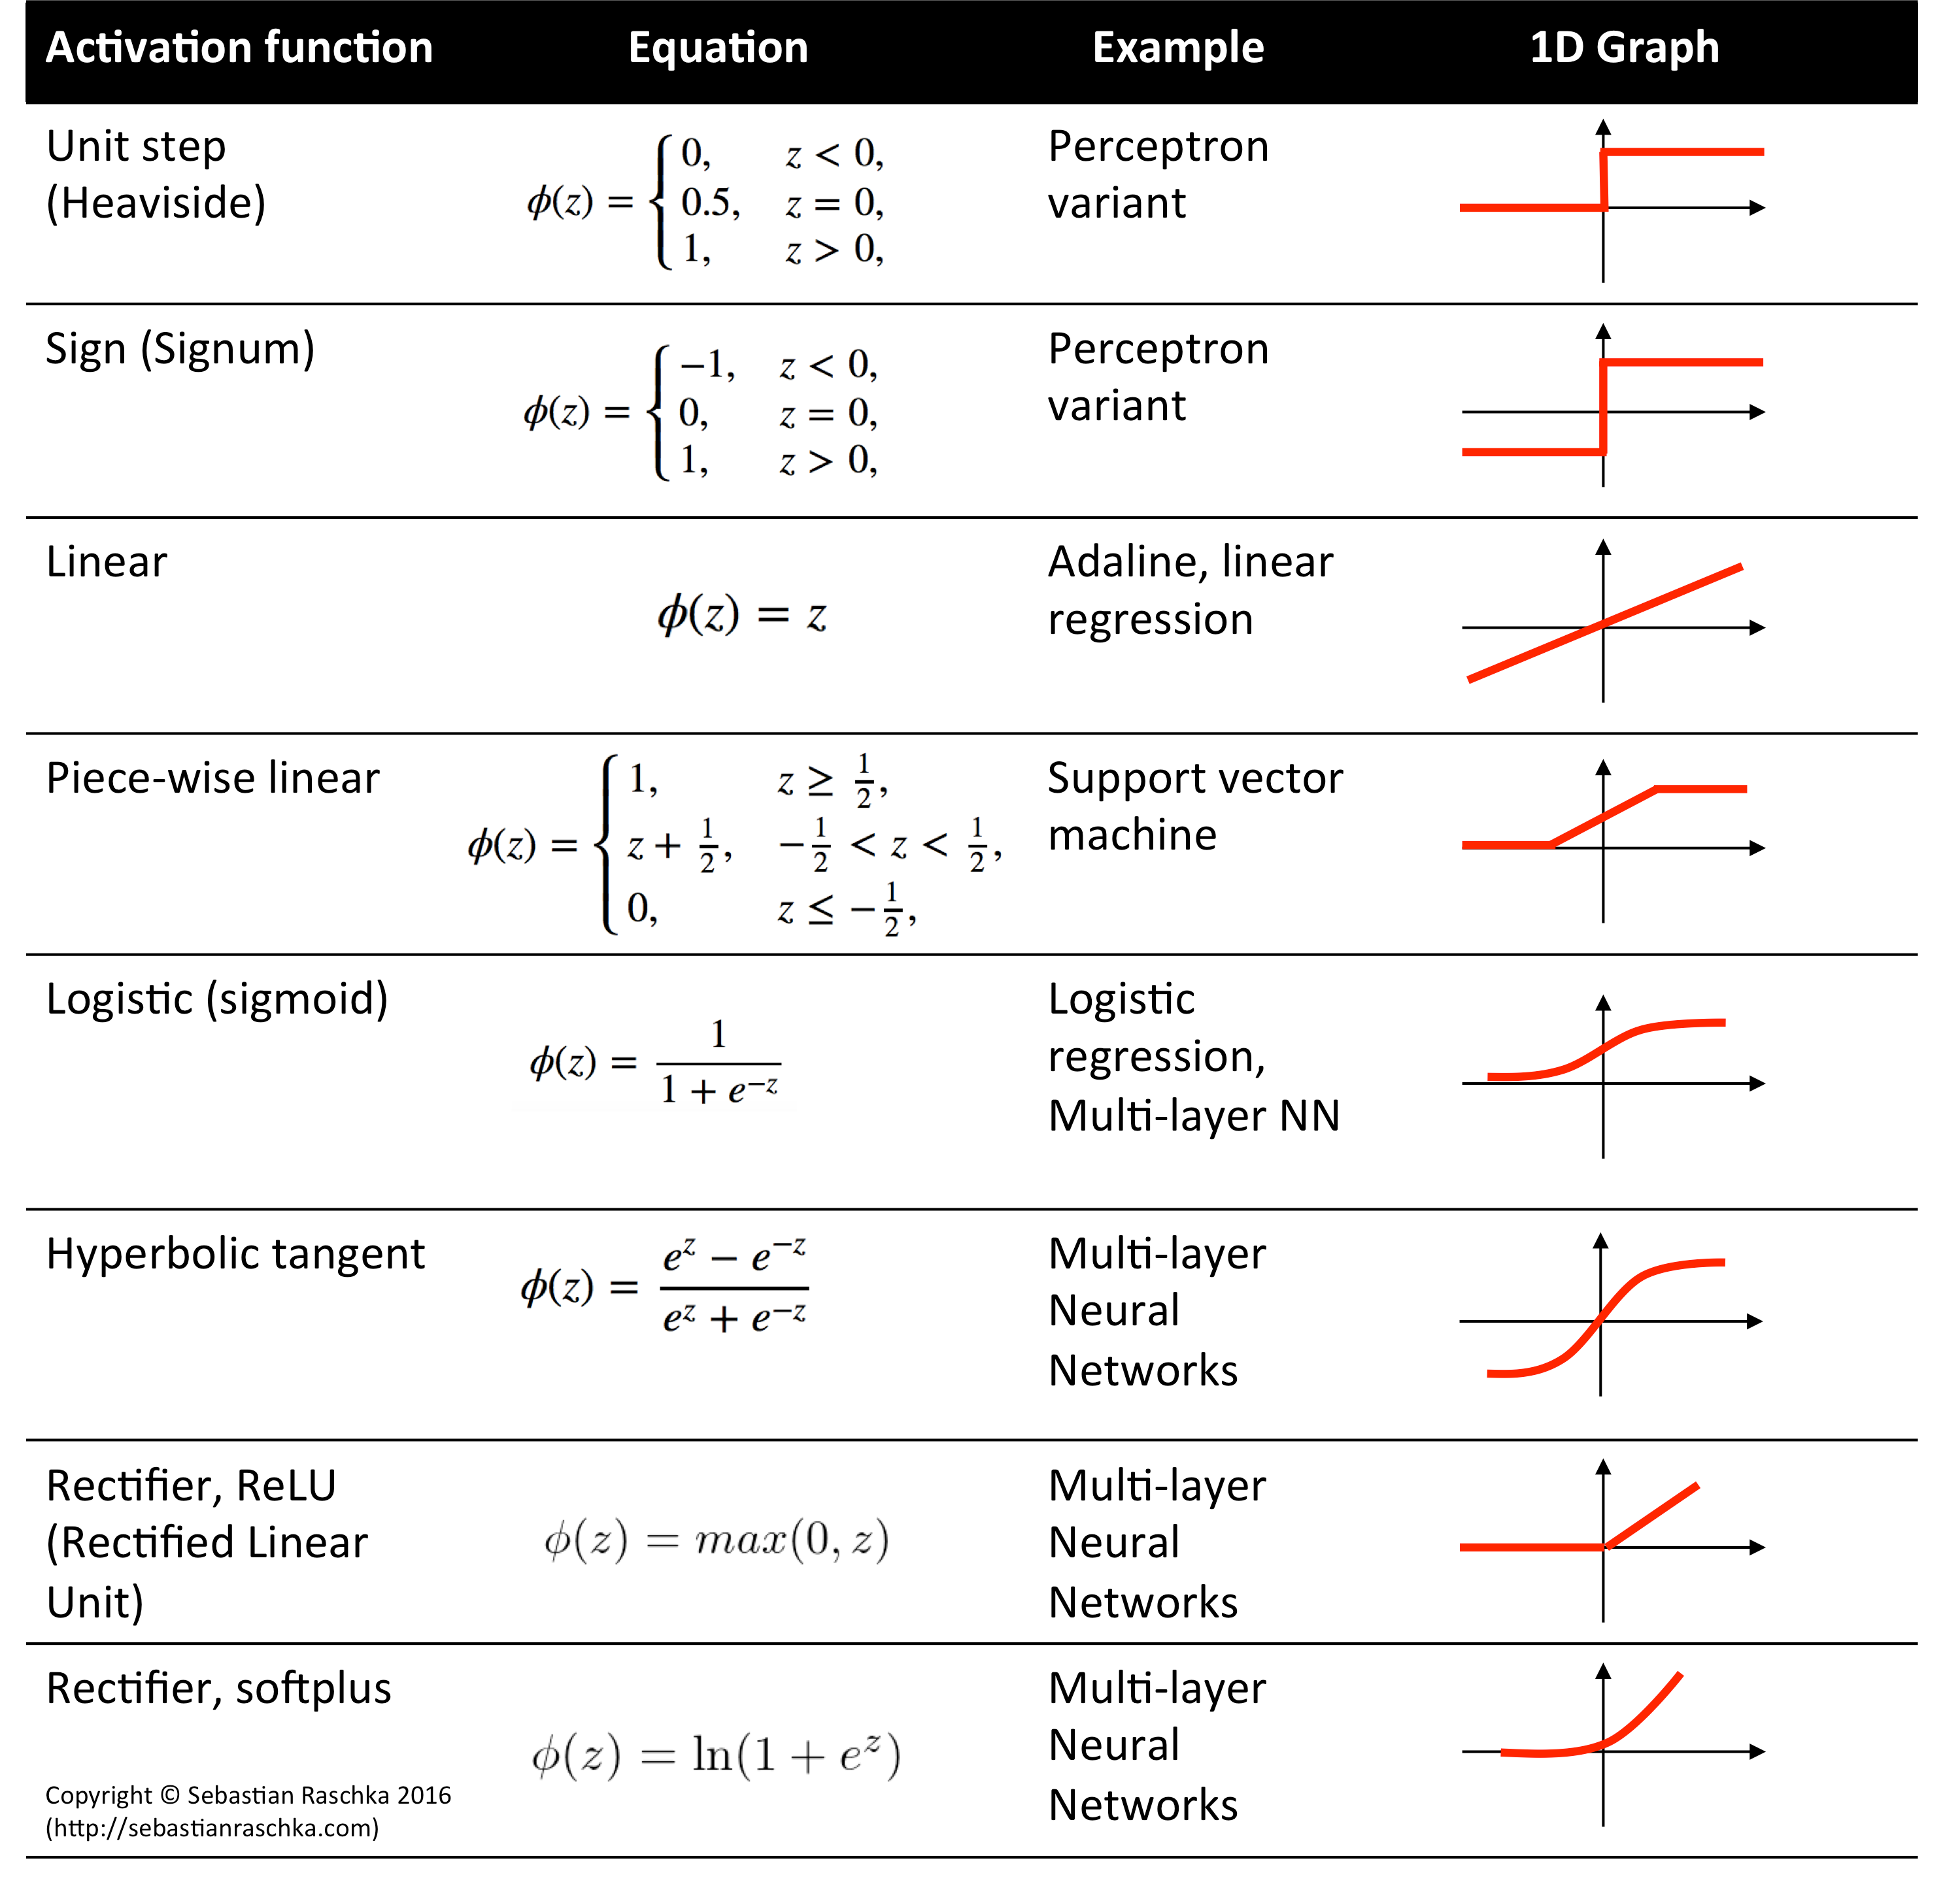

Slide 41
Learning Resources
https://cs231n.github.io/neural-networks-1/
https://www.youtube.com/watch?v=wEoyxE0GP2M
Deep Learning(CS7015)- NPTEL-IITMadras https://www.youtube.com/watch?v=6XhSJbfT1pk
MIT Introduction to Deep Learning | 6.S191 https://www.youtube.com/watch?v=7sB052Pz0sQ
https://www.youtube.com/watch?v=icZItWxw7AI

Slide 42
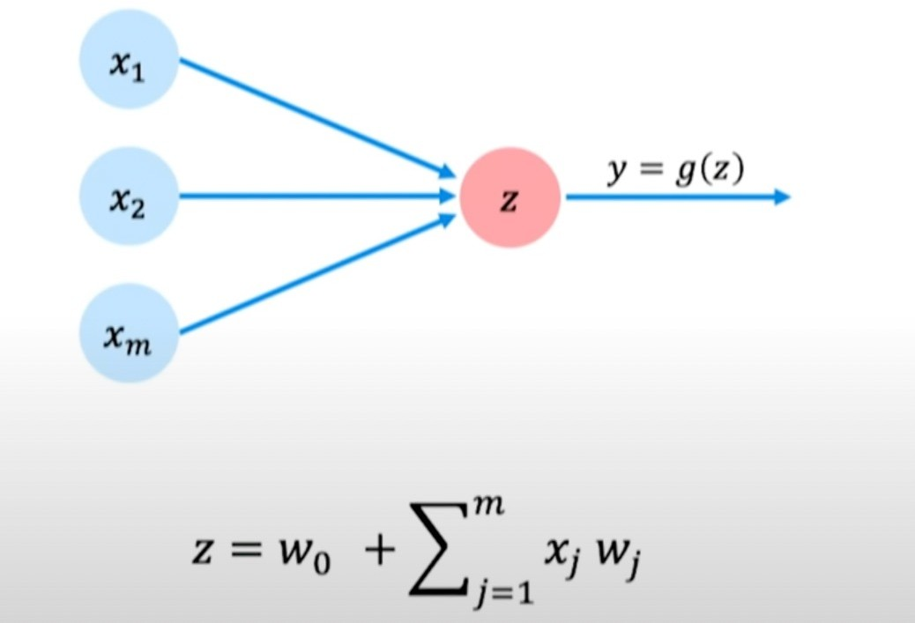
Perceptron - simplified

Slide 43
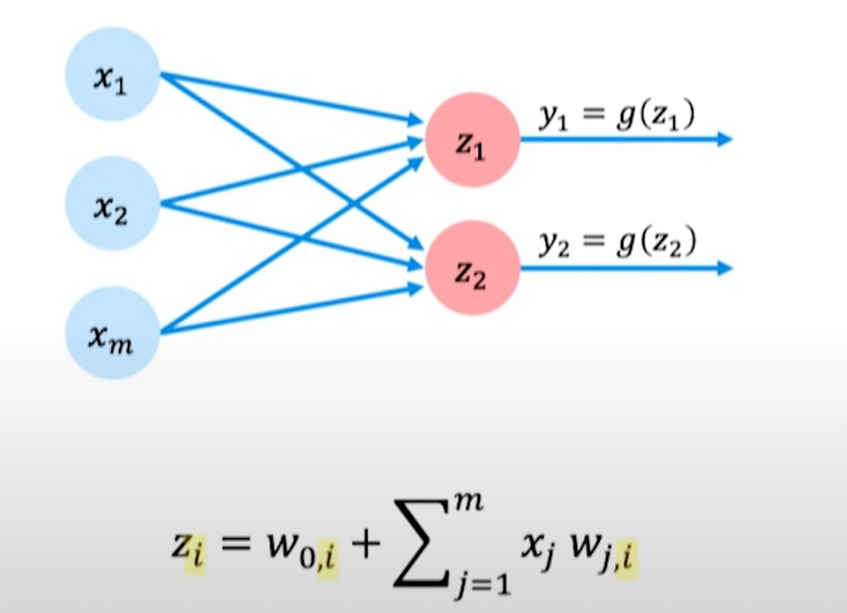
Multi Output Perceptron

Slide 44

Single Layer Neural Network

Slide 45

Single Layer Neural Network

Slide 46

Single layer Neural Network
Back Propagation
Loss function
X1
W (1)
W (2)
y1(x)
Ground truth labels
….
ym(x)
Output Layer
Hidden Layer
Xn
Input Layer

Slide 47



Slide 48

Fully Connected Deep Neural Network

Slide 49


Example Problem
Will I pass this course?
Let’s start with a simple two feature model:

Slide 50

Example Problem

Slide 51

Quantifying loss

Slide 52


Slide 53

Empirical Loss

Slide 54
Empirical Loss

Slide 55


Slide 56


Slide 57


Slide 58


Slide 59

Single error calculation is called as Loss.
Mean of all errors are calculated as Cost Function

Slide 60

1 EPOCH
One full training of all the neurons

Slide 61

Training Neural Networks
Loss Optimization

Slide 62


Slide 63

Training Neural Networks
Loss Optimization

Slide 64

Training Neural Networks
Loss Optimization

Slide 65

Training Neural Networks
Loss Optimization

Slide 66

Training Neural Networks
Loss Optimization

Slide 67

Training Neural Networks
Loss Optimization

Slide 68
Representation Power of Neural Networks
The representation power of a given neural network for provided function to be approximated.
Mathematically speaking, they are very good at approximating behavior of any complex function.
Let’s understand this concept of approximation visually instead of a forward and backward propagation approach in which error in prediction is minimized.
Representation power is related to ability of a neural network to assign proper labels to a particular instance and create well defined accurate decision boundaries for that class

Slide 69

Representation Power of Neural Networks
MP Neuron which is very simplified model of a neuron.
For checking its representation power let’s see a geometric interpretation. First a 2-D analysis with 2 inputs for approximating OR function

Slide 70

Representation Power of Neural Networks
3-D analysis with 3 inputs.

Slide 71
Representation Power of Neural Networks
More flexibility is achieved with Perceptrons having weights attached to each of its inputs but strict demarcation still exists.
But, the above mechanisms fails for non linearly separable functions.
A very simple example is XOR, imagine drawing a separating line in a 2-D plane for this function.
There won’t be one!
TRY THIS OUT!! (HOMEWORK)
Very much like XOR most of the data is linearly inseparable in nature.

Slide 72
Representation Power of Neural Networks
Advanced computational models like neural networks are required for these creating a separating boundaries for these functions.
Representation power of sigmoidal neurons is much higher. A multilayer network of neurons with a single hidden layer can be used to approximate any continuous function to any desired precision.
In the mathematical terms, the universal approximation theorem states that an autoencoder network with a single hidden layer containing a finite number of neurons can approximate continuous functions on compact subsets of R(n), under mild assumptions on the activation function. The theorem thus states that simple neural networks can represent a wide variety of functions when given appropriate parameters.

Slide 73

Representation Power of Neural Networks
A function can be approximated with superimposing several towers functions.
Interpretation of Universal Approximation Theorem tells us that more number of towers we use for approximation, better will be the approximation behaviour.
The illustrative proof that we just saw tells us that we can have a neural network with two hidden layers which can approximate the above function by a sum of towers.

Slide 74




Feed Forward Neural Networks
The pre-activation at layer i is given by:
The activation at layer i is given by:

Slide 75

Feed Forward Neural Networks

Slide 76

Learning parameters in Feed Forward Neural Networks
What will be the total no of parameters?

Slide 77

Output and loss functions of FFN Networks
A loss function is a function that compares the target and predicted output values; measures how well the neural network models the training data.
The hyperparameters are adjusted to minimize the average loss — we find the weights, wT, and biases, b, that minimize the value
of J (average loss).
https://towardsdatascience.com/loss-functions-and-their-use-in-neural-networks-a470e703f1e9

Slide 78
Output and loss functions of FFN Networks

Slide 79
Output and loss functions of FFN Networks

Slide 80
Output and loss functions of FFN Networks

Slide 81

Computing gradients
CC
Backpíopagation- computes gíadients of expíessions thíough íecuísive application of chain íule.

Slide 82
Computing gradients
CC
How does a small change in one weight (eg. w₂)affect the final loss J(W)?

Slide 83


Computing gradients
How does a small change in one weight (eg. w₂)affect the final loss J(W)?
CC
?

Slide 84

Chain rule
In calculus, the chain rule is a formula that expresses the derivative of the composition of two differentiable functions f and g in terms of the derivatives of f and g.
If a variable z depends on the variable y, which itself depends on the variable x (that is, yand z are dependent variables), then z depends on x as well, via the intermediate variable y.
Y=2x
CC
In this case, the chain rule is expressed as

Slide 85

Chain rule - intuition
EXAMPLE:
If a car travels twice as fast as a bicycle and the bicycle is four times as fast as a walking man, then the car travels ?? times as fast as the man.
The relationship between this example and the chain rule is as follows. Let z, y and x be the (variable) positions of the car, the bicycle, and the walking man, respectively.
CC
The rate of change of relative positions of the car and the bicycle is dz/dy =2 ; similarly, dy/dx=4
So, the rate of change of the relative positions of the car and the walking man is?

Slide 86


Slide 87



Slide 88
Computing gradients
How does a small change in one weight (eg. w₂)affect the final loss J(W)?
CC
?

Slide 89


Slide 90


Slide 91


Slide 92


Slide 93


Slide 94


Slide 95


Slide 96

Computing gradients
CC
Apply īhe chain íule īo decompose inīo īwo gíadienīs īhaī we have access īo.

Slide 97

Computing gradients
CC

Slide 98

Computing gradients
CC
Repeaī īhis foí eveíy weighī in īhe neīwoík using gíadienīs fíom laīeí layeís

Slide 99
Backpropagation learning algorithm
Backpropagation Algorithm:
Step 1: Inputs X, arrive through the preconnected path.
Step 2: The input is modeled using true weights W. Weights are usually chosen randomly.
CC
Step 3: Calculate the output of each neuron from the input layer to the hidden layer to the output layer.
Step 4: Calculate the error in the outputs Backpropagation Error= Actual Output – Desired Output
Step 5: From the output layer, go back to the hidden layer to adjust the weights to reduce the error.
Step 6: Repeat the process until the desired output is achieved.

Slide 100
Backpropagation learning algorithm
Need for Backpropagation:
Backpropagation is “backpropagation of errors” and is very useful for training neural networks.
It’s fast, easy to implement, and simple.
Backpropagation does not require any parameters to be set, except the number of in^{CC} puts.
Backpropagation is a flexible method because no prior knowledge of the network is required.
Disadvantages:
It is sensitive to noisy data and irregularities. Noisy data can lead to
inaccurate results.
Performance is highly dependent on input data.
Spending too much time training.

Slide 101

Backpropagation example
A neural network with two inputs, two hidden neurons, two output neurons. Additionally, the hidden and output neurons will include a bias.
CC
https://mattmazur.com/2015/03/17/a-step-by-step-backpropagation-example/

Slide 102

Backpropagation example
CC

Slide 103

Backpropagation example
GOAL: Given inputs 0.05 and 0.10, we want the neural network to output 0.01 and 0.99.
(i) The Forward Pass
- Calcula^{CC} ting the Total Error
(ii) The Backward Pass
Partial derivatives
Chain rule
Update weights
(REPEAT)

Slide 104





Backpropagation : Forward pass
CC
We repeat this process for the output layer neurons, using the output from the hidden layer neurons as inputs.

Slide 105


Backpropagation : Forward pass
Calculating the Total Error
Calculate the error for each output neuron using thesquared error function and sum them to get the total error:
CC
For example, the target output for o₁ is 0.01 but the neural network output 0.75136507, therefore its error is:

Slide 106



Backpropagation : Backward pass
The goal with backpropagation is to update each of the weights in the network so that they cause the actual output to be closer the target output, thereby minimizing the error for each output neuron and the network as a whole.
By applying the chain rule, we know that:

Slide 107

Backpropagation : Backward pass

Slide 108





Backpropagation : Backward pass
Output Layer

Slide 109


Backpropagation : Backward pass

Slide 110


Backpropagation : Backward pass
Hidden Layer

Slide 111




Backpropagation : Backward pass

Slide 112




Backpropagation : Backward pass

Slide 113


Backpropagation : Backward pass

Slide 114
Backpropagation : Backward pass
When we fed forward the 0.05 and 0.1 inputs originally, the error on the network was 0.2983.
After this first round of backpropagation, the total error is now down to 0.2910.
It might not seem like much, but after repeating this process 10,000 times, for example, the error is 0.000035.
At this point, when we feed forward 0.05 and 0.1, the two outputs neurons generate 0.0159 (vs 0.01 target) and 0.9840 (vs 0.99 target).

Slide 115
Learning Resources
Slide credits: MIT Deeplearning: https://youtu.be/7sB052Pz0sQ
https://mattmazur.com/2015/03/17/a-step-by-step-backpropagation- example/
https://cs231n.github.io/neural-networks-1/
https://cs231n.github.io/optimization-2/
https://archive.nptel.ac.in/courses/106/106/106106184/
https://www.youtube.com/watch?v=wEoyxE0GP2M

